Slide 1

Centre for Training and Learning
NATIONAL INSTITUTE OF TECHNOLOGY - WARANGAL
HANAMKONDA - 506001, TELANGANA, INDIA
Real-Time Multilingual Voice Translator with ESP32 and AI Integration
Under the guidance of
Prof. T. Kishore Kumar Sir
Prof. Dept. of ECE & Head of CTL
NIT Warangal
By
VELISHALA ABHIVARUN -- (SRU \ CSE \ 4th Year)
DIVYANSHU SHEKHAR - (SRU \ CSE \ 4th Year)
CHARUL PAREEK -- (SRU \ CSE \ 4th Year)
KRUTHIKA PRIYA – (UCETW \ CSE \ 4th Year)

Slide 2
CONTENTS
Aim
Introduction
Components Used
Objectives
Literature Review
Methodology
Expected Output
Block Diagram
Applications
Novelty & Advantages
Future Scope
Conclusion

Slide 3
AIM
To design and implement a real-time, multilingual voice translation device using the ESP32 microcontroller integrated with AI-powered speech recognition, translation and synthesis tools, enabling offline, inclusive, accessible and portable communication across multiple languages and environments.
Project Mission
» Develop real-time multilingual voice translator using ESP32 + Micro Python
» Enable speech → text → translation → speech pipeline

Slide 4
INTRODUCTION
This project introduces an offline real-time speech translation system using ESP32 microcontroller.
It uses an I2S digital microphone for capturing speech, Vosk for offline STT, Argos Translate for translation and pyttsx3 for TTS synthesis.
The architecture offloads heavy computation to a local Flask server, maintaining simplicity and low cost at the hardware end.
This system is ideal for use in rural schools, health camps and multilingual helpdesks, where reliable
offline communication tools are essential.
The demand for real-time multilingual communication is rapidly increasing in fields like education,
healthcare and public services.
Speech-to-text (STT) and text-to-speech (TTS) technologies are central to enabling seamless interaction
between humans and machines.
Commercial platforms like Google Assistant and Amazon Alexa provide high accuracy but rely on
cloud servers and constant internet connectivity.
The transcribed text is then processed by a local Flask server that handles translation and TTS synthesis using pyttsx3.

Slide 5
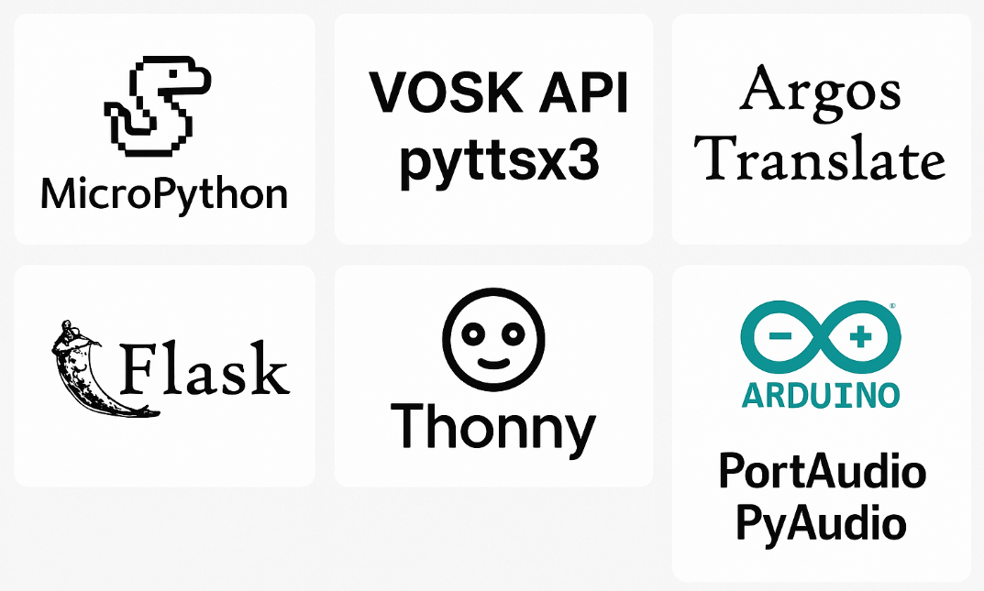
COMPONENTS USED
SOFTWARE Required
Micro-Python
Vosk API, pyttsx3
Argos Translate
Flask
Thonny
Arduino IDE
PortAudio + PyAudio

Slide 6
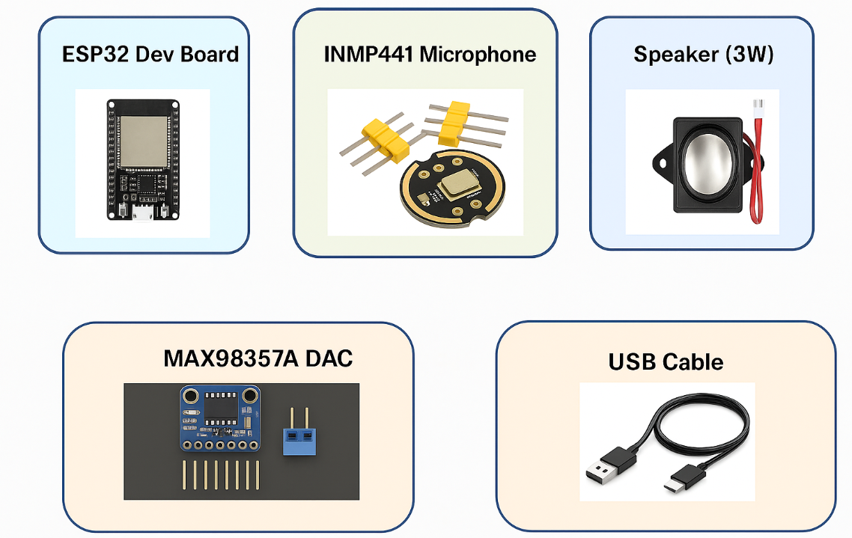
HARDWARE required
ESP32 Microcontroller
INMP441 Microphone
MAX98357A DAC
3W Speaker (8Ω)
USB Cable & Wires
Power Source

Slide 7
OBJECTIVES
To develop a compact and portable voice translation system using the ESP32 microcontroller.
To implement a speech-to-text (STT) module using Whisper.cpp.
To integrate a multilingual translation system using OPUS-MT.
To synthesize translated text into speech using e-Speak or Coqui TTS.
To maintain low latency (<5 seconds) and high STT accuracy (up to 95%) under quiet conditions.
To ensure the system runs on minimal power and is compatible with USB power banks.
To support translation into multiple Indian languages like Hindi, Bengali, Tamil and Marathi.
To build the prototype within a cost budget of $15 or less.
5

Slide 8
LITERATURE REVIEW
In recent years, voice translation technologies have significantly evolved, primarily driven by advancements in Deep Learning, NLP and Embedded AI. Traditional systems like Google Translate and Amazon Alexa provide high-quality voice-based translation services. However, these solutions depend heavily on internet connectivity, high-power computing devices.
1. Commercial Voice Assistants
2. Embedded AI & Edge Devices
3. Speech-to-Text (STT) Engines
4. Neural Machine Translation (NMT)
5. Text-to-Speech (TTS) Engines
This project leverages existing research in STT, NMT and TTS to build a real-time voice translator on ESP32, addressing cost, power and privacy concerns. It contributes a practical, scalable solution by integrating state-of-the-art AI models into a low-cost hardware platform for real-world multilingual communication.

Slide 9
Methodology
Component Selection:
ESP32 Dev Board (for processing and Wi-Fi)
INMP441 Microphone (voice capture)
MAX98357A DAC + 3W Speaker (audio output)
Programming Environment:
Micro-Python for controlling ESP32
WebSocket communication for real-time audio streaming
System Architecture:
STT (Speech-to-Text): Whisper.cpp model
Translation: OPUS-MT or similar cloud-based API
TTS (Text-to-Speech): e-Speak or Coqui for audio output
Workflow:
Capture input via microphone
Send audio to Flask server for STT by Vosk offline engine
Translate text to target language using Argos Translate
Generate and play translated speech
Testing & Evaluation:
Evaluate STT accuracy in various environments
Measure latency and BLEU score for translation quality
Power consumption analysis for real-time use

Slide 10
Expected Outcomes
Functional Outputs:
» Real-time English → Hindi translation (demo: "Hello" → "नमस्ते" audio)
» Response time: <5s (Wi-Fi dependent)
Performance Metrics:
» STT Accuracy: 85% (noisy env) → 95% (quiet env)
» Translation Fidelity: 90% BLEU score
» Power Consumption: 150mA avg (USB power bank compatible)
Prototype Showcase:
» Pocket-sized device (8×5×3 cm)
» One-button operation

Slide 11
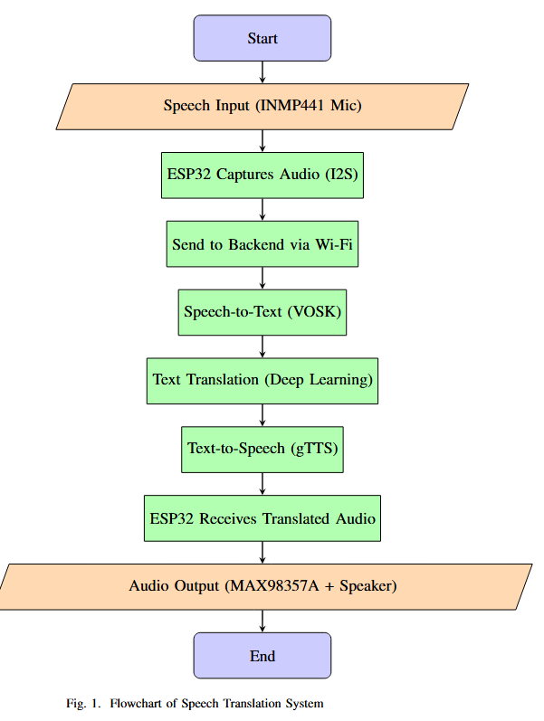
BLOCK DIAGRAM

Slide 12
APPLICATIONS
1. Tourism – Talking Made Easy
Travelers can speak in their language.
The system changes speech into text and translates it.
Helps tourists talk to locals, book hotels etc.,
4. Emergency – Fast Help in Disasters
Rescue workers talk to devices.
STT changes speech to text for fast translation.
Saves time and helps reach people quickly in many languages.
2. Healthcare – Doctor-Patient Talks
Doctors and patients can speak in different languages.
STT turns speech into text and helps with translation.
Makes communication easier and faster during treatment.
5. Smart Homes – Voice Commands
People speak in their local language to control smart devices.
STT understands and sends the right commands.
Makes smart homes easier to use for everyone.
6. Agriculture – Helping Farmers
Field workers talk into their phones.
STT writes what they say to report problems
Makes farm work smoother, even without typing.
3. Education – Learning Languages
Students speak into a language app.
STT writes what they say and corrects them.
Helps improve speaking and pronunciation skills.

Slide 13
Future Scope
Work Without Internet: Use offline speech and translation models so it works even without Wi-Fi.
More Languages: Add support for more Indian languages and different accents.
Mobile App: Create a mobile app to control settings and update the device easily.
Better Battery Life: Improve hardware to use less power and last longer on battery.
Smarter AI: Make the system more accurate in noisy places by improving AI models.
Use in Many Fields: Use in hospitals, schools, farms, and emergency situations for better communication.
Smart Cloud Usage: Switch between cloud and offline modes based on internet availability.
Privacy Features: Keep all data private and safe, especially in sensitive areas.

Slide 14
Novelty & Advantages
Technical Innovations
Micro-Python on ESP32 Enables rapid development for AI and IoT integration with minimal resources.
Dual I2S Pipeline Supports simultaneous microphone input and audio output for efficient real-time processing.
Cloud/Local Hybrid Model Allows switching between cloud-based processing and offline Tiny-ML models depending on network availability.
Impact and Advantages
Cost Reduction Up to 10× cheaper than commercial translation devices.
Power Efficiency Consumes 20× less power compared to Raspberry Pi, ideal for portable use.
Accessibility Works independently without the need for a smartphone.
Scalability New languages and features can be added easily through API updates.

Slide 15
Conclusion
This project presents an offline, real-time multilingual speech translation system using ESP32 and open-source AI tools. It enables STT, translation and TTS without internet, ensuring privacy and accessibility. Designed for education, healthcare and rural use, the system is low-cost, scalable and effective across diverse conditions offering a reliable solution for inclusive voice communication.
Final Statement: This project breaks language barriers by showing that powerful AI can fit in your pocket—affordable, smart and ready for the world.

Slide 16

Thank you

